Slide 1
USER AUTHENTICATION SYSTEM
INTRODUCTION
In an increasingly digital world, the need for a robust authentication user system is paramount for secure management of user data and access controls. This document proposes a comprehensive approach to building such a system using various technologies tailored for web application development.
Authentication is the cornerstone of user security, ensuring that users are accurately identified while protecting sensitive information from unauthorized access. A well-implemented authentication system not only safeguards user data but also instills confidence in the application.

Slide 2
Technologies Used
The proposed system leverages the following technologies:
Node.js: A server-side JavaScript runtime that allows for efficient handling of asynchronous events and requests.
Express: A minimal web framework for Node.js, facilitating smooth routing and middleware integration.
JSON Web Tokens (JWT): Used for secure user authentication, enabling stateless session handling and reducing server load.
Cookies: Essential for managing user sessions, they store authentication tokens in the browser for seamless access.
Body-parser: Middleware that parses incoming request bodies, simplifying data handling for APIs.
CORS (Cross-Origin Resource Sharing): Configured to permit secure interactions between web pages and APIs hosted on different domains.
Path: A Node.js module for handling file and directory paths, enhancing file management in the application.

Slide 3
Technologies Used
Nodemailer: is a Node.js module used for sending emails. It allows your application to send transactional emails suchas account verification, password reset, and notifications.

Slide 4
PROJECT STRUCTURE
The system follows a structured approach to organizing backend files:
server.js: Main server entry point.
routes/userRoutes.js: Handles API endpoints related to user authentication.
middleware/authMiddleware.js: Protects routes and ensures users are authenticated.
controllers/userController.js: Implements logic for user registration, login, profile management, and logout.
frontend/script.js: Manages frontend logic for user authentication and interaction

Slide 5
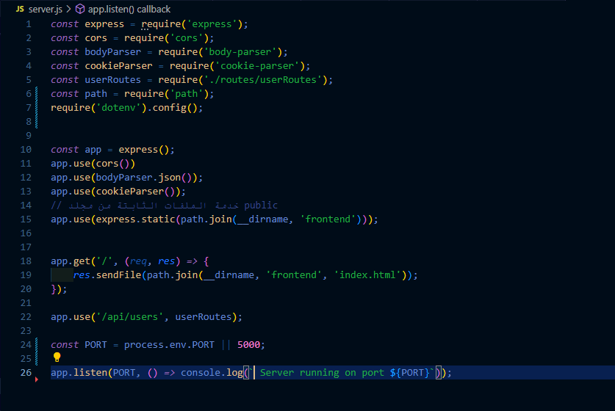
SERVER IMPLEMENTATION
server.js
The server is set up using Express and includes middleware for parsing request bodies, handling CORS, and managing cookies. The public directory is used to serve static frontend files.

Slide 6
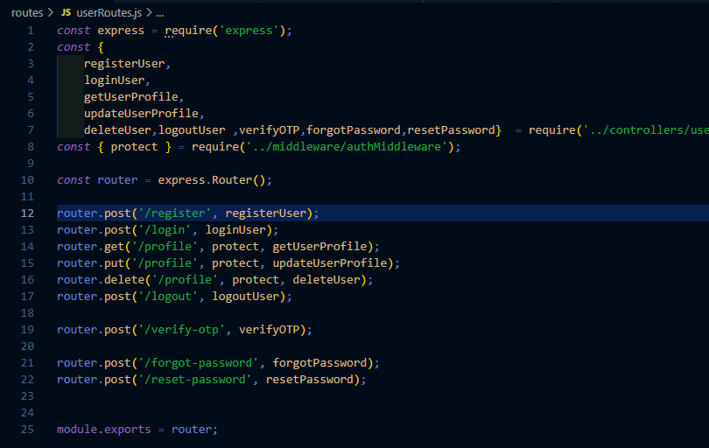
USER AUTHENTICATION ROUTES
routes/userRoutes.js
Defines API endpoints for user operations such as registration, login, profile management, and logout.

Slide 7
AUTHENTICATION MIDDLEWARE
middleware/authMiddleware.js
Validates JWT tokens stored in cookies.

Slide 8
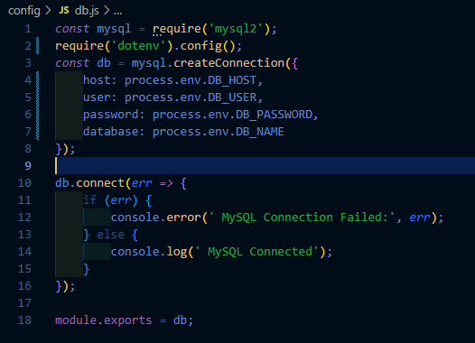
Config-db.js
+------------------+
| users |
+------------------+
id | int AI PK
name | varchar(255)
email | varchar(255)
password | varchar(255)
phone | varchar(15)
address | text
created_at | timestamp
updated_at | timestamp
otp_code | varchar(6)
otp_expires | datetime
is_verified | tinyint(1)

Slide 9
USER CONTROLLER LOGIC
controllers/userController.js
Handles user authentication and profile management, including:
User Registration
User Login
Fetching Profile Data
Updating User Details
User Logout

Slide 10
JWT Authentication
This system implements JWT Authentication to secure user login and protect access to resources. User credentials are validated during registration, passwords are securely hashed, and a JWT token is generated upon successful login.

Slide 11
JWT Authentication
User Registration
Steps:
Validate user input.
Check if the email is already in use.
Hash the password using bcrypt.
Store the user in the database.
Return a success response upon registration.
User Login
Steps:
Validate login credentials.
Retrieve the user from the database using the provided email.
Compare the entered password with the hashed one in the database.
If authentication is successful, generate a JWT token containing the user ID.
Send the token to the client via an HTTP-only Cookie for security.

Slide 12
JWT Authentication
JWT Authentication Flow
Stages:
User Login: The user submits credentials, authentication is verified, and a JWT is issued.
Token Storage: The token is stored in an HTTP-only Cookie or Local Storage.
Accessing Protected Routes: The user sends requests including the JWT.
Token Verification: The server verifies the token in each request to ensure the user's identity
Middleware is used to intercept requests and enforce authentication by verifying the JWT token before allowing access to protected routes.

Slide 13
User Profile Management This section explains how the system handles retrieving and updating user profile data securely using Node.js, Express, and MySQL.
Fetching User Profile
Process Flow:
Extracts the user ID from the JWT token.
Queries the database for user details (id, name, email, phone, address).
If the user is found, the data is returned in JSON format.
If the user does not exist, a 404 error is sent

Slide 14
User Profile Management This section explains how the system handles retrieving and updating user profile data securely using Node.js, Express, and MySQL.
Updating User Profile
.
Process Flow:
Extracts user ID from the JWT token.
Checks if a new password is provided:
If yes: Hashes the password using bcrypt before storing it.
If no: Updates only the Executes the UPDATE query to modify user data. name, phone, and address.
Returns a success message upon completion.

Slide 15
User Profile Management
Security Considerations
JWT Authentication: Ensures only authenticated users can access and modify their profiles. Hashed Password Storage: Uses bcrypt to prevent plaintext password exposure. SQL Query Parameterization: Prevents SQL injection attacks.

Slide 16
Client-Server Side Validation
This JavaScript code handles the validation and management of user input on the client side for a registration and login system
1. Input Validation (validateRegisterInputs function)
This function performs client-side validation to ensure that all fields are filled out correctly before submission:
Name Validation: Checks if the name field is not empty.
Email Validation: Uses a regular expression to ensure the email format is correct.
Password Validation: Ensures the password is at least 6 characters long.
Phone Validation: Verifies that the phone number contains only digits
.
Address Validation: Checks if the address field is not empty.
If any validation fails, the corresponding error message is displayed, and the form is not submitted until all inputs are valid.

Slide 17
Client-Server Side Validation
2. User Registration (register function)
Collects user inputs (name, email, password, phone, address) from the registration form.
Validates the inputs using the validateRegisterInputs function.
If valid, sends a POST request to the server with the user data (name, email, password, phone, address) in JSON format.
If registration is successful, the user is redirected to the login page. If there is an error, an alert is shown.

Slide 18
Client-Server Side Validation
3. User Login (login function)
Collects the user's login credentials (email and password).
Sends a POST request to the server to verify the credentials.
If the login is successful, a JWT token is stored in localStorage, and the user is redirected to their profile page. If login fails, an alert is shown.

Slide 19
Client-Server Side Validation
4. Fetch User Profile (loadProfile function)
Retrieves the JWT token from localStorage.
If the token exists, a GET request is made to fetch the user's profile data.
The profile data (name, email, phone, and address) is displayed on the profile page.
If the token is missing or the session has expired, the user is redirected to the login page.

Slide 20
Client-Server Side Validation
5. Update User Profile (updateUserProfile function)
Retrieves the JWT token from localStorage.
Sends a PUT request to the server with updated profile information (name, phone, address).
If the update is successful, the user is notified and redirected to their profile page. If an error occurs, an alert is displayed.

